Slide 1
Organisation structure
Name :-Dhruvik Bhatt
Enroll:-160410116015
Sy It-1

Slide 2
The nature of organisation structure
The formal pattern of interactions and coordination designed by management to link the tasks of individuals and groups in achieving organisational goals.
Organisation charts are diagrams that show the internal structure of the business. They make it easy to identify the specific roles and responsibilities of staff. They also show how different roles relate to one another and the structure of departments within the whole company.

Slide 3
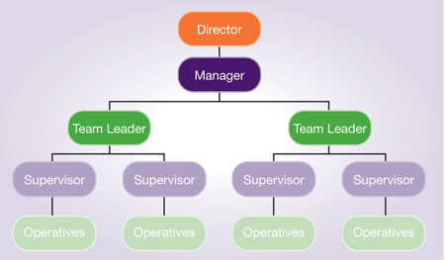
Organisation chart

Slide 4
Departmentalisation
Clustering individuals into units, and units into departments and larger units, to achieve organisational goals.

Slide 5
Types of departmentalisation
Functional structure
Divisional structure
Matrix structure
Hybrid structure

Slide 6
Functional structure
A structure in which positions are grouped according to their main functional (or specialised) area.
CEO
MANAGER MANUFACTURING UNIT
MANAGER DISTRIBUTION UNIT
MANAGER ADMINSITRATION

Slide 7
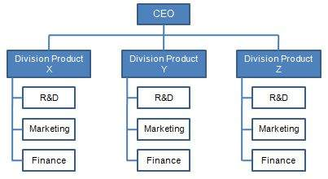
Divisional structure
A structure in which positions are grouped according to similarity of products, services or market

Slide 8
Matrix structure
Matrix structure is the realisation of two-dimensional structure which emanates directly from two dimensions of authority.
Two complementary structures-Pure project structure & functional structure –are merged together two create matrix structure.

Slide 9
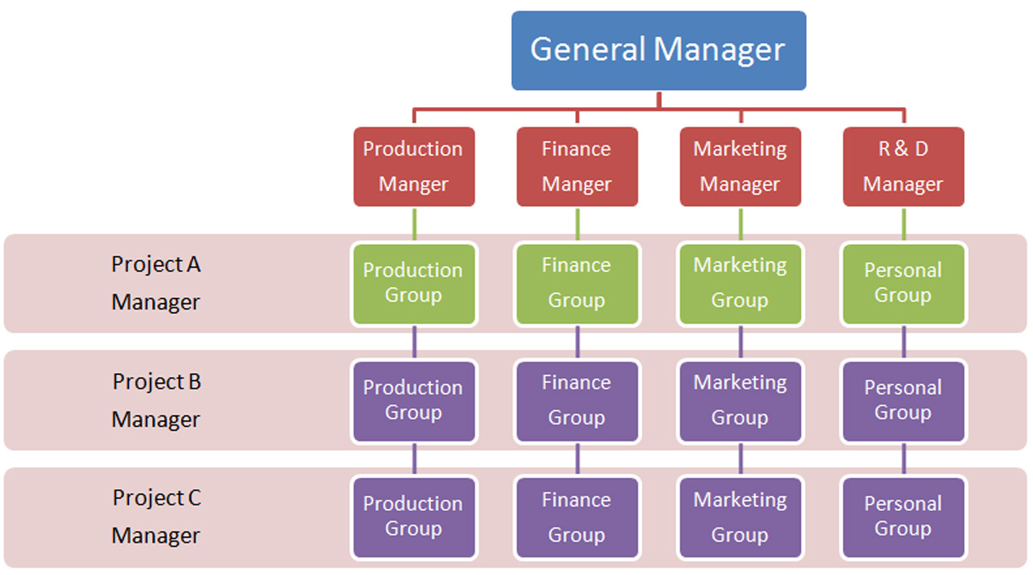

Slide 10
Hybrid structure
A hybrid organization is an organization that mixes elements, value systems and action logics (e.g. social impact and profit generation) of various sectors of society, i.e. the public sector, the private sector and the voluntary sector.

Slide 11
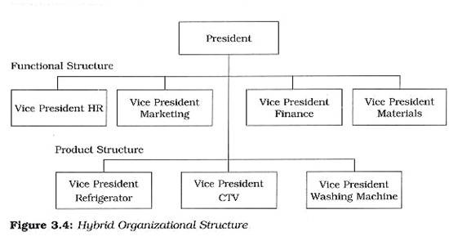

Slide 12
Case study on Starbucks
Starbucks Coffee Company is the largest coffeehouse chain in the world. The firm’s industry leadership is partly attributed to the appropriateness of its organizational structure. A company’s organizational structure influences management and leadership, communication, change, and other variables critical to business success. Starbucks has evolved to have an organizational structure that matches current business needs. This organizational structure is unique to Starbucks, although it can be characterized based on a conventional typology of organizational structures. Starbucks succeeds because its organizational structure grows with the business, enabling the company to optimize processes and the quality of its goods and services.

Slide 13
Features of Starbucks Coffee’s Organizational Structure
Starbucks has a matrix organizational structure, which is a hybrid mixture of different features from the basic types of organizational structure. The following are the main features of Starbucks Coffee’s organizational structure:
Functional structure
Geographic divisions
Product-based divisions
Teams

Slide 14
Functional Structure
The functional structure feature of Starbucks Coffee’s organizational structure refers to grouping based on business function. For example, the company has an HR department, a finance department and a marketing department. These departments are most pronounced at the top levels of Starbucks Coffee’s organizational structure, such as at the corporate headquarters. This feature relates with hierarchy in the organizational structure of Starbucks. For instance, the corporate HR department implements policies applicable to all Starbucks cafés. The functional structure feature of the firm’s organizational structure facilitates top-down monitoring and control, with the CEO at the top.

Slide 15
Geographic Divisions
Starbucks Coffee’s organizational structure also involves geographic divisions. At present, the company has three regional divisions for the global market: (a) China and Asia-Pacific, (b) Americas, and (c) Europe, Middle East, Russia and Africa. Also, in the U.S. market, Starbucks Coffee’s organizational structure involves further geographic divisions: (a) Western, (b) Northwest, (c) Southeast, and (d) Northeast. Each geographic division has a senior vice president. In this way, each Starbucks manager reports to two superiors: the geographic head (e.g. President of U.S. Operations) and the functional head (e.g. Corporate HR Manager). This feature of Starbucks Coffee’s organizational structure supports closer managerial support for geographic needs. Each division head is given a high degree of flexibility in adjusting strategies and policies to suit specific market conditions.

Slide 16
Product-based Divisions
Starbucks also uses product-based divisions in its organizational structure. These divisions address product lines. For example, Starbucks has a division for coffee and related products, another division for baked goods, and another division for merchandise like mugs. This feature of the firm’s organizational structure enables focus on certain product lines. In this way, Starbucks effectively develops and innovates its products with support from its organizational structure.

Slide 17
Teams
Teams are used in different parts of Starbucks Coffee’s organizational structure. However, teams are most notable at the lowest organizational levels, particularly the Starbucks cafés. In each café, the firm has teams organized to deliver goods and service to customers. This feature of Starbucks Coffee’s organizational structure enables the company to provide effective and efficient service to consumers.

Slide 18
Thank you

